Slide 1
ALTA/NSPS Standards Session 31
Jerry Mahun, PLS jerry.mahun@gmail.com https:\\jerrymahun.com 715-896.3178

Slide 2
ALTA/NSPS Standards
A. Background
B. ALTA/NSPS Standards Organization
C. Required Elements
D. Table A
E. Summary

Slide 3
A. Background
1. Title Insurance
If a grantee needs a mortgage, the lending institution will require title insurance to protect its interests.
Title Insurer can provide two types of policies:
Lender - in effect only for life of the loan
Owner - in effect as long as the property is owned by the insured party
Title Insurer has two protection duties for title issues
Duty to defend - when a conflict arises that is covered by the policy
Duty to indemnify for loss - when the insured suffers a financial loss for a covered item.

Slide 4
A. Background
1. Title Insurance
Title Policy has three parts
Schedule A : type and amount of insurance coverage, owner's information, general property information.
Schedule B-Part 1 : Requirements to satisfy before policy will be issued, eg, satisfaction of liens, payment of taxes, documents to record, etc. These are similar requirements for all policies.
Schedule B-Part 2 : Documents & circumstances that are exempted from B-Part 1 coverage. There are some standard exceptions found during a title search (eg, dropped easement, lien, etc) and boundary issues that would be determined by a property survey.

Slide 5
A. Background
2. Property Survey
Is not required when conveying land between parties.
Grantor or grantee could order one prior to transaction.
Land surveyor will perform it according to local and state standards and common law.
The survey standards can vary across jurisdictions.
No warranty besides the surveyor's certification and potential liability.
Ahem!

Slide 6
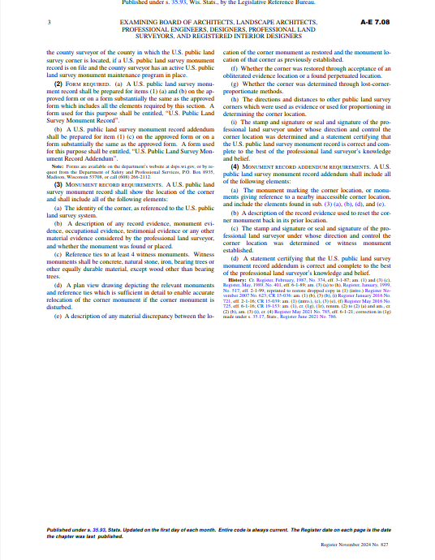
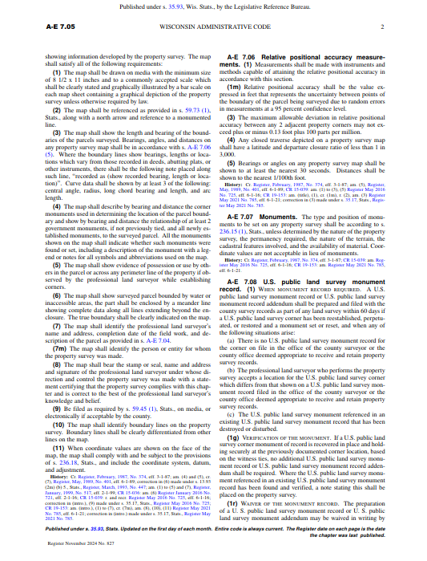
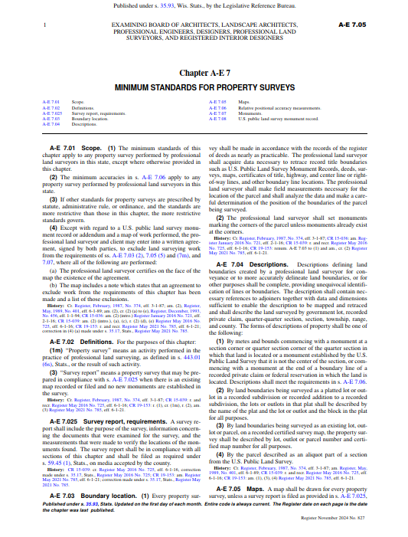
A. Background
2. Property Survey
Requirements and procedures
Parcel creation: statute law
Wis Stat 236, 703 etc
Admin Code A-E 7
Parcel retracement: statute and common law
Admin Code A-E 7
Wis Court system

Slide 7
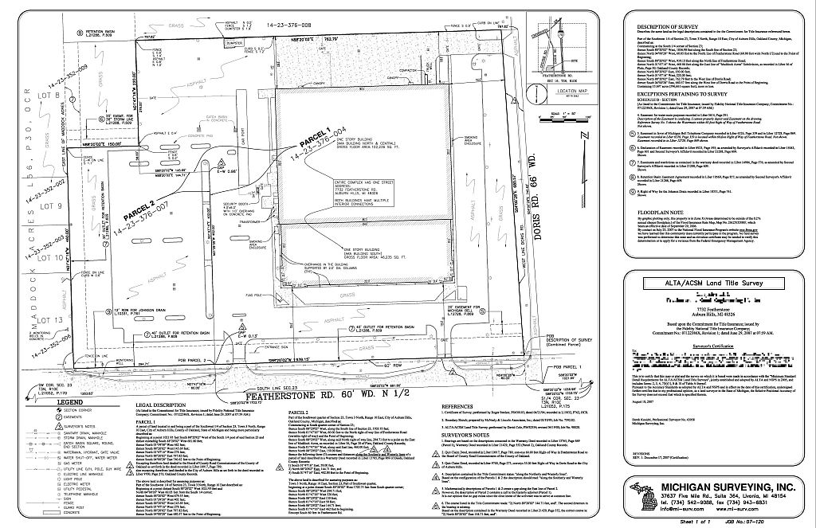
A. Background
3. Land Title Survey (LTS)
Is used for boundary issues in Schedule B-Part 2.
An LTS is a Property Survey; it differs in that:
It generally contains greater detail.
Its requirements and standards are more uniform across jurisdictions.
It is part of the title policy which financially warrants the property.
All the additional data are those things which are often title issues.

Slide 8
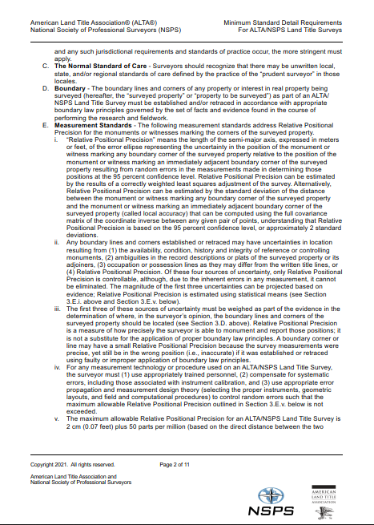
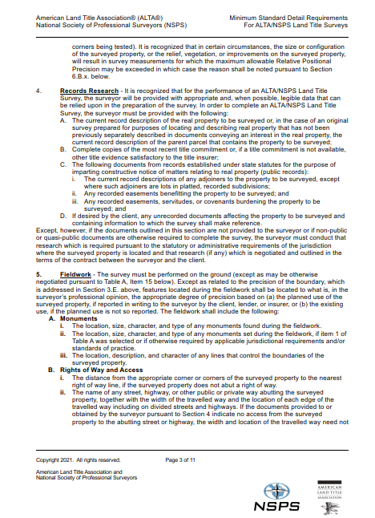
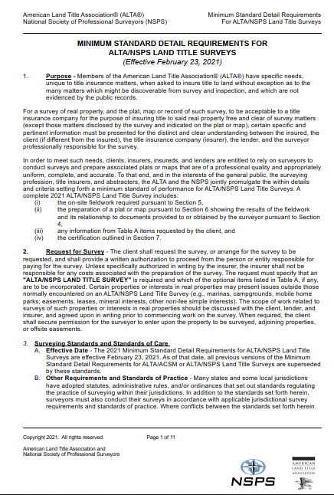
A. Background
3. Land Title Survey (LTS)
Requirements and procedures
ALTA/NSPS Standards Minimum Detail Requirements for ALTA/NSPS Land Title Surveys
Parcel recreation or retracement principles
Work in conjunction with State & Local laws
Property and Land Title Surveys both depend on
Proper research
Surveyor judgement
Appropriate surveying principles

Slide 9
A. Background
4. ALTA/NSPS Standards Development
Originally developed by the American Land Title Assoc (ALTA) and American Congress on Surveying and Mapping (ACSM) in c1962
2012 ACSM merged into National Society of Professional Surveyors (NSPS)
Standards are continuously updated - 2021 latest version

Slide 10
B. ALTA/NSPS Standards Organization
The Standards Are divided into two parts: Required and Optional
Required: Elements for all LTS
1. Purpose
2. Request for Survey
3. Surveying Standards
4. Records research
5. Fieldwork
6. Plat or Map
7. Certification
Optional: Table A
Other elements required by client.
Will differ based on situation, location, proposed use, etc.

Slide 11
C. Required Elements
Section 1 Purpose
Reason for an LTS - insuring title.
An LTS includes:
Fieldwork
Plat
Table A items
Certification
Each item has its own section with details.
Section 2 Request for Survey
There must be written authorization from the client to execute the survey.
Must specify that an "ALTA/NSPS Land Title Survey" is required and identify Table A items to include.
Any other items are agreed upon in writing; contract.
Scope of work, Liability limitation, payment/penalties, deliverables, etc.

Slide 12
C. Required Elements
Section 3: Survey Standards and Standards of Care
General process, measurement standards, research, etc, for the survey.
Sub-Section A: Effective Date:
Latest standards supersede all earlier versions.
Updated every few years therefor important to identify which are used.
Sub-Section B: Other Requirements and Standards of Care
State/Local requirements must also be met.
When in conflict the more stringent of State/Local or ALTA/NSPS will be used.

Slide 13
C. Required Elements
Section 3: Survey Standards and Standards of Care
General process, measurement standards, research, etc, for the survey.
Sub-Section C: The Normal Standard of Care
Competent surveyor in the context of local and/or regional expectations or standards.
Sub-Section D: Boundary
Boundaries are retraced according to appropriate boundary law principles and state/local laws.
Record data
Written, physical, parol evidence
Rules of Construction

Slide 14
C. Required Elements
Section 3: Survey Standards and Standards of Care
Sub-Section E: Measurement Standards
Potentially the most confusing aspect of the Standards.
Relative Positional Precision (RPP) is the "length of the semi-major axis, expressed in meters or feet, of the error ellipse representing the uncertainty in the position of the monument or witness marking any boundary corner of the surveyed property relative to the position of the monument or witness marking an immediately adjacent boundary corner of the surveyed property resulting from random errors in the measurements made in determining those positions at the 95 percent confidence level."
Got it?
N
a
b
E
a: semi-major axis

Slide 15
C. Required Elements
Section 3: Survey Standards and Standards of Care
Sub-Section E: Measurement Standards
What ...
... is an error ellipse?
... are random errors?
... does 95% confidence level mean?
N
a
b
E
a: semi-major axis

Slide 16
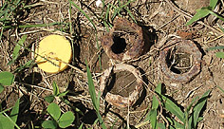
C. Required Elements
Section 3: Survey Standards and Standards of Care
Sub-Section E: Measurement Standards
Every measurement is subject to errors: Mistakes, Systematic, & Random
Mistake | Blunder Ex: Measuring to the wrong point; Using wrong HI Comp: Check/verify; Remeasure

Slide 17
C. Required Elements
Section 3: Survey Standards and Standards of Care
Sub-Section E: Measurement Standards
Systematic | Conforms to a mathematical or physical law Ex: Curvature & refraction; Bubble run Comp: Mathematical corr'n or procedure
VA
VA
z
=90°

Slide 18
C. Required Elements
Section 3: Survey Standards and Standards of Care
Sub-Section E: Measurement Standards
Random | Errors left after mistakes corrected and systematic compensated. Tend to be small and ± Measurement Ex: Total Sta Dist MSA: ±(2 cm + 3 ppm) Setup Ex: Instrument centering Comp: Are always present, but can minimized procedurally.
E_{R}
MSA
E_{I}
E_{I} – Instrument centering error
E_{R} – Reflector centering error
MSA – Distance error

Slide 19
C. Required Elements
Section 3: Survey Standards and Standards of Care
Sub-Section E: Measurement Standards
Example of random error sources in angle measurement
BS
Target centering error;
Sighting error
D_{BS}
Target centering error;
Sighting error
TSI
Centering error;
Angle resolution error;
Number of repetitions
D_{FS}
FS
Highlighted: Errors we control

Slide 20
C. Required Elements
Section 3: Survey Standards and Standards of Care
Sub-Section E: Measurement Standards
Example of random error sources in GPS measurement
Well...
Centering: Base/Rover
Baseline MSA
Observation quality
PDOP
Atmos modeling
S/N ratio - multipath
Cycle slip
Site calibration control
. . .
C
B
Base
NEZ
A

Slide 21
C. Required Elements
Section 3: Survey Standards and Standards of Care
Sub-Section E: Measurement Standards
An error ellipse is a graphic representation of two-dimensional uncertainty based on random error accumulation.
Except for fixed points, each point will have its own network error ellipse which is an estimate of that point’s absolute position uncertainty.
Fixed
N
a
b
E
a: semi-major axis
Absolute: Network

Slide 22
C. Required Elements
Section 3: Survey Standards and Standards of Care
Sub-Section E: Measurement Standards
A relative error ellipse is the uncertainty between points. This is a local uncertainty.
N
Fixed
N
a
a
b
E
E
b
Standard
Relative
Ellipse
a: semi-major axis
Absolute: Network
Relative: Local

Slide 23
C. Required Elements
Section 3: Survey Standards and Standards of Care
Sub-Section E: Measurement Standards
The RPP is the 95% CI relative error ellipse between points.
Max allowable RPP is 2 cm (0.07 feet) plus 50 ppm
N
95% CI Ellipse
Fixed
Fixed
N
a₉₅=RPP
a
Each line has its own RPP
b
b₉₅
E
E
a: semi-major axis
Absolute: Network
Relative: Local

Slide 24
C. Required Elements
Section 3: Survey Standards and Standards of Care
Sub-Section E: Measurement Standards
How to determine the 95% relative error ellipses between adjacent property corners?
"Relative Positional Precision can be estimated by the results of a correctly weighted least squares adjustment of the survey. Alternatively, Relative Positional Precision can be estimated by the standard deviation of the distance between the monument ... and the... immediately adjacent boundary corner ... computed using the full covariance matrix of the coordinate inverse ..."
Which is why we use software.

Slide 25
C. Required Elements
Section 3: Survey Standards and Standards of Care
Sub-Section E: Measurement Standards
Max allowable RPP is 2 cm (0.07 feet) plus 50 ppm
Two-part error that propagates as an Error of a Sum:
Check adjustment results to these.
520 ft
F
E
700 ft
600 ft
10.5 ac
G
H
1030 ft

Slide 26
C. Required Elements
Section 3: Survey Standards and Standards of Care
Sub-Section E: Measurement Standards
Positional uncertainty also affected by legal elements:
Condition and character of monumentation
Ambiguities – patent and latent; resolution potential
Occupation (possession) vs title (deed) lines
Legal elements are a function of intent, record data, and evidence
RPP is only an indicator of the measurements’ quality, It is not a reflection of records research, evidence evaluation, or corner location.
Technology doesn’t drive legal decisions.
You can have great RPP using wrong corners.

Slide 27
C. Required Elements
Section 3: Survey Standards and Standards of Care
Sub-Section E: Measurement Standards
Once legal decisions are reached, measurements help memorialize them and identify spatial relationships.
For the measurement technology or procedure employed, the surveyor must:
Use appropriately trained personnel
Compensate systematic errors
Use correct procedures and network design to control random errors
The RPP is the standard (the "what"), the specification (the "how") is the surveyor's responsibility,

Slide 28
C. Required Elements
Section 3: Survey Standards and Standards of Care
Sub-Section E: Measurement Standards
Example: Narrow parcel RTK-GPS project.
Each point had two short occupations
Dist to City GPS Base approx. 2.4 miles
Weights: baseline error [±(8 mm + 1 ppm)]. rover centering (±0.05 ft)
StarNet least squares adjustment
 | Adjustment |  | Allowable
Line | Adj Length (ft) | RPP (ft) | RPP (ft) | Pass?
701-702 | 299.379 ±0.154 | ±0.077 | ±0.072 | No
702-703 | 63.571 ±0.162 | ±0.077 | ±0.070 | No
703-704 | 268.470 ±0.102 | ±0.067 | ±0.071 | Yes
704-701 | 65.972 ±.0139 | ±0.079 | ±0.070 | No
704
703
701
702
Ellipses scaled 150X

Slide 29
C. Required Elements
Section 3: Survey Standards and Standards of Care
Sub-Section E: Measurement Standards
RPP Failure? Things to consider:
Field procedure(s)
Modify network
Higher accuracy instruments
Careful equipment centering
Repeat measurements
Verify systematic errors are compensated
eg: optical plummet?
GPS
Increase observation times
Re-occupy points
Independent measurements

Slide 30
C. Required Elements
Section 3: Survey Standards and Standards of Care
Sub-Section E: Measurement Standards
RPP Failure? Things to consider:
Software/Analysis
“correctly weighted least squares adjustment”
Mixed quality measurements
Instrumental errors
Personal errors (centering, HI determination)
Not all software packages allow complete a priori estimates
Sec 3Ei. RPP 95% CI is “approximately 2 standard deviations."
StarNet and some other software packages use 2.54 multiplier
Others use multiplier based on number of redundancies (F-Statistic).
For this survey example the multiplier is 3.40.

Slide 31
C. Required Elements
Section 3: Survey Standards and Standards of Care
Sub-Section E: Measurement Standards
Comparison of the different ways to determine the 95% CI
 | RPP Multiplier
 | StarNet | ALTA | F-Statistic | Allowable
Line | 2.54 | 2.00 | 3.40 | RPP
701-702 | ±0.077 | ±0.061 | ±0.103 | ±0.072
702-703 | ±0.077 | ±0.061 | ±0.103 | ±0.070
703-704 | ±0.067 | ±0.026 | ±0.090 | ±0.071
704-701 | ±0.079 | ±0.031 | ±0.106 | ±0.070
 | Red means passing
704
703
701
702
Ellipses scaled 150X
A project that fails in one software package might pass in another.
How does your software determine the 96% CI?
Does it support complete instrument and personal errors?

Slide 32
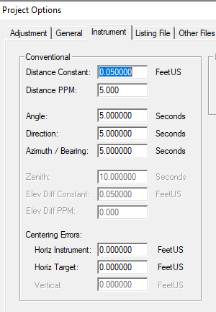
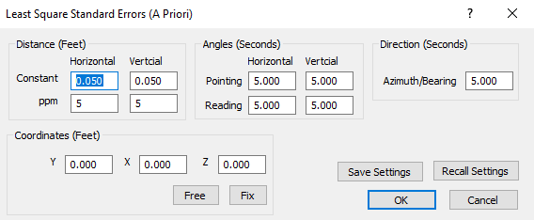
C. Required Elements
Section 3: Survey Standards and Standards of Care
Sub-Section E: Measurement Standards
"Correctly weighted least squares adjustment"
StarNet allows entry of instrumental and personal a priori values
Traverse PC only allows entry of instrumental a priori values.

Slide 33
C. Required Elements
Section 3: Survey Standards and Standards of Care
Sub-Section E: Measurement Standards
Remember that RPP is a measurement quality indicator.
It is not an indicator of legal corner correctness.
You can have a passing RPP on a line that is in between wrong corners.
Despite equipment, procedures, weighing, etc, site conditions may affect ability to achieve RPP on every line.
Those lines affected must be noted on final plat including the reason.
Described in Section 6.

Slide 34
C. Required Elements
Section 4: Records Research
Unlike a property survey where the surveyor does all the records research, for a LTS he/she is to be provided with title data on which to base the survey.
A. Current record description of the parcel or current record description of the parent parcel that contains the property;
B. Complete copies of the most recent title commitment or other title evidence satisfactory to the title insurer;

Slide 35
C. Required Elements
Section 4: Records Research
C. The following documents:
Current record descriptions of adjoiners, except where they are lots in platted, recorded subdivisions;
Any recorded easements benefitting the property
Any recorded easements, servitudes, or covenants burdening the property
These can be the most challenging aspect to find
Can have latent effect on property.
D. If desired by the client, any unrecorded documents affecting the property and containing information to which the survey makes reference.

Slide 36
C. Required Elements
Section 4: Records Research
What if complete records are not provided or additional documents are required?
Surveyor must conduct the research
Per State/Local requirements
Prudent surveying practice
As defined in contract
An LTS survey does not relieve the surveyor of research responsibility.
At least a title commitment or current abstract must be provided or the survey cannot be called a Land Title Survey.

Slide 37
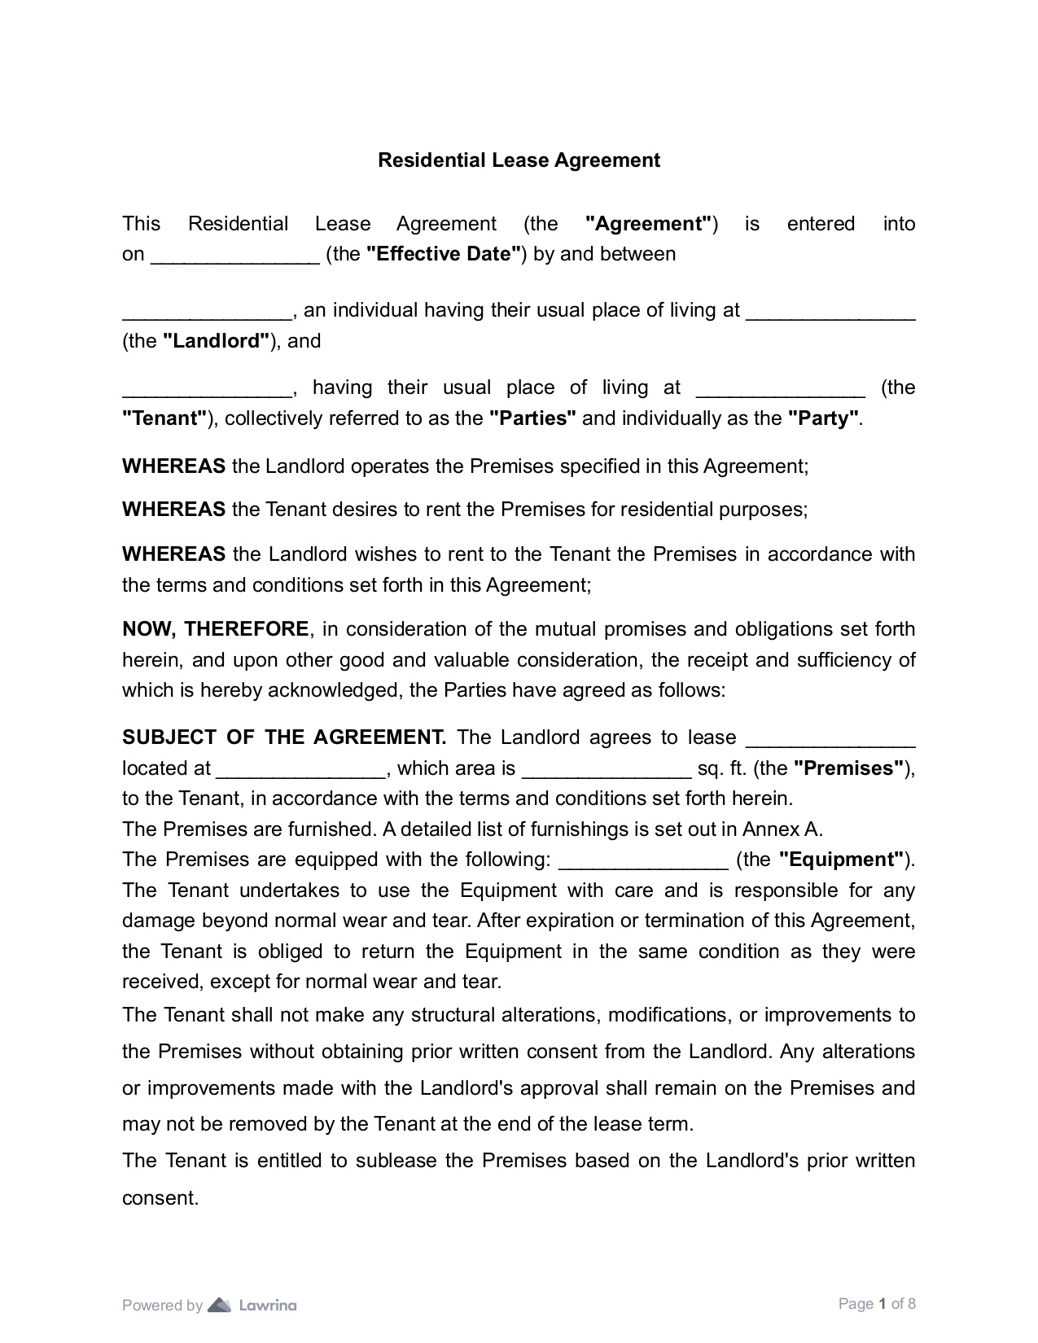
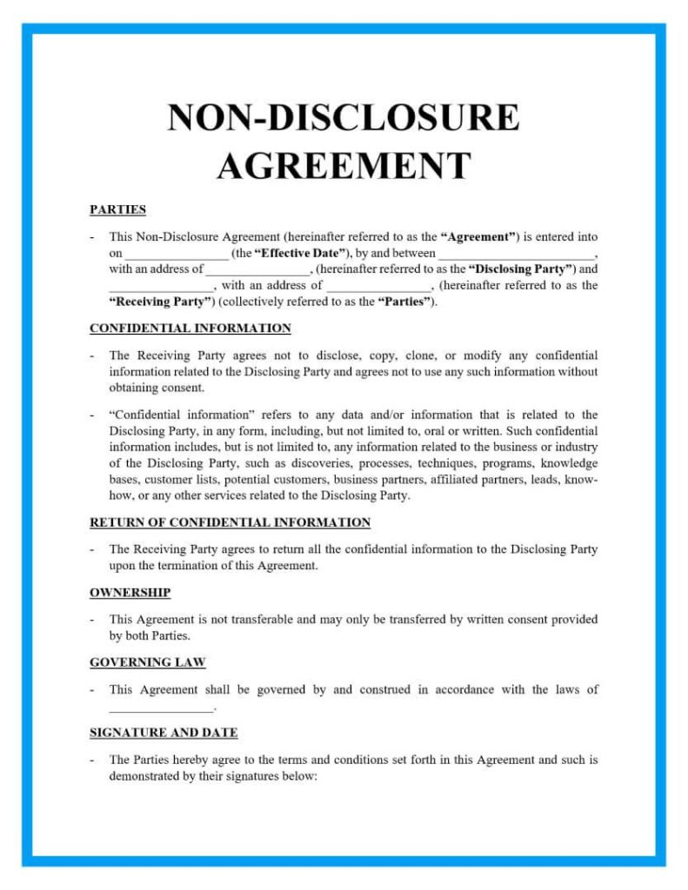
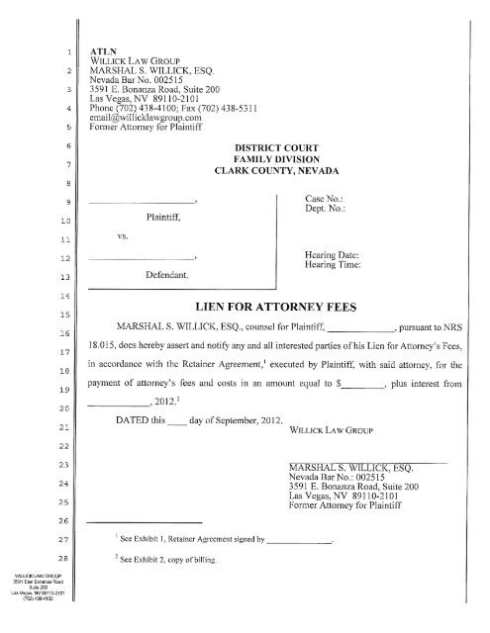
C. Required Elements
Section 4: Records Research
What about other records that may impact the property?
Non-survey stuff that appear in the documents?
Restrictions
Covenants
Leases
Leins
Basically, surveyor is responsible for "plottable" things
Matters of Survey: Concerns boundaries
vs
Matters of Title: Concerns rights

Slide 38
C. Required Elements
Section 5: Fieldwork
The survey must be performed on the ground.
There are exceptions in Table A.
Except as otherwise required for boundary corners and lines, surveyor’s discretion how precisely to locate other features.
Any encroachment identified and mapped is without legal opinion.
eg, surveyor doesn't determine adverse possession but could be collecting evidence of it.

Slide 39
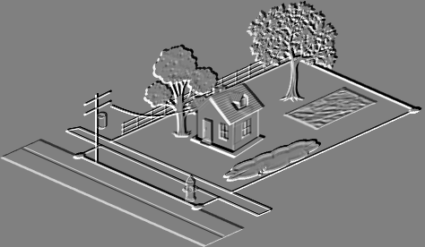
C. Required Elements
Section 5: Fieldwork
A. Monuments: location, size, type, character
Found and set (Table A or jurisdictional)
Lines that control parcel boundary
B. Rights-of-Way (RoW) & access
Nearest access location if property doesn’t abut a RoW
Name, size, & dimension of abutting streets
Visible evidence of physical access
Visible evidence of access to/across property by other than owner.
Visible evidence of encroaching access (w/o expressing legal opinion)
Visible evidence of waterway access
Potential
prescriptive
easements

Slide 40
C. Required Elements
Section 5: Fieldwork
C. Possession & Improvements along Boundaries
Occupation/possession evidence by owner or adjoiners
Improvements within 5 feet on both sides of the line
Vegetation only if specified or is occupation evidence
Location of potentially encroaching structures
D. Buildings on the property
Potential
prescriptive
easements
MH
MH

Slide 41
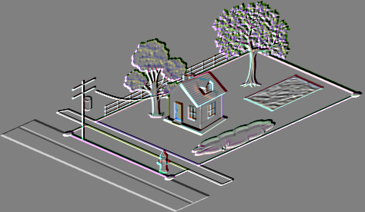
C. Required Elements
Section 5: Fieldwork
E. Easements and Servitudes
Evidence of those on provided documents
Evidence of those not on doc
Surface indications of underground easements
Observed evidence of easements on or above the property
Utility poles w/in 10 ft of boundary
Utility locate markings (eg, Diggers Hotline) can be used as utility evidence.
Identify source of markings.
What about "...and subject to any easements of record." disclaimer?

Slide 42
C. Required Elements
Section 5: Fieldwork
F. Cemeteries
Documented or observed
Burial area perimeter
Isolated gravesites
Mounds?
G. Water features
On, through, or w/in 5’ of perimeter
Include streams, lakes, ponds, canals, ditches, marshes, swamps, etc.
Boundary waters
As per description: Lake (OHWM), Stream (centerline), unless otherwise indicated

Slide 43
C. Required Elements
Section 6: Plat or Map
There is a lot of map detail required in Section 6.
Basically, everything collected in Section 5 must appear in some form on the map.
In coherent fashion with explanatory notes as necessary.
Map dimension precisions on the map determined by surveyor based on
(a) planned use of the property as reported to the surveyor, or
(b) existing use.
Man, that’s a lotta stuff!

Slide 44
C. Required Elements
Section 6: Plat or Map
A. Field Locations
All data collected under Section 5, with notes as needed, will be shown unless otherwise indicated in this Section.
B. Boundary. Descriptions, Dimensions, and Closures - 12 areas
Major points
i. Current description (existing parcel) or that of parent (new parcel)
ii. Writing a new description for existing parcel:
Should be avoided, particularly if parcel is a Subdiv lot. Why?
If a new one is written, a statement should be included that explains why it was written.
Also, that it either describes the same property as the record description or how it differs.

Slide 45
C. Required Elements
Section 6: Plat or Map
B. Boundary. Descriptions, Dimensions, and Closures - 12 areas
Major points
iii. Record dimensions shown unless resurveyed values are sufficiently different in the surveyor's judgement
iv. Sufficient dimensions to compute mathematical closure.
A note if record description doesn't close
v. Parent parcel graphically depicted, need not be part of the LTS, except as needed to establish lines.
vi. Water boundary. Include note:
date it was surveyed
attributes located
subject to natural changes & may not be title limits

Slide 46
C. Required Elements
Section 6: Plat or Map
B. Boundary. Descriptions, Dimensions, and Closures - 12 areas
Major points
vii. Adjoiner relationships
Gaps or overlaps disclosed to insurer and client prior to final map delivery
viii. Notes on plat if surveyor believes survey results differ significantly from record
ix. Building locations dimensioned perpendicular to boundary.
x. Note explaining site conditions along a line where RPP was nor achieved.
xi. Note explaining areas where physical boundary access within 5 feet was restricted.
xii. Note identifying title evidence provided, date, and name of insurer.

Slide 47
C. Required Elements
Section 6: Plat or Map
C. Easements, Servitudes, Rights of Way, Access, and Documents
Location & info on record easements
Summary of all R/W & easements & other survey-related matters that burden the property
Note if no physical access was observed
Location of abutting or crossing R/W and info source
Recorded plats, filed plats, R/W maps, etc, survey represents
Recoding data & tax parcel ID for adjoining parcels
Setback lines, building restriction lines
If surveyor discovers a recorded easement not included in provided insurer's title evidence must advise insure prior to map delivery.

Slide 48
C. Required Elements
Section 6: Plat or Map
D. Presentation
Map requirements
Min sheet size: 8-1/2 x 11
Drawn at "standard" scale
Standard map elements: Scale statemet & graphic, North arrow, Legend, Vicinity map, Sheet numbers, etc.
Detail diagrams as needed.
Revision dates
Table A modifications
"No buildings observed" if none are present
Must be captioned "ALTA/NSPS Land Title Survey

Slide 49
C. Required Elements
Section 7: Certification
In all states, any property resurvey by a land surveyor requires a map on which the surveyor attests to following appropriate rules and laws. This is signed and dated.
ALTA/NSPS survey is similar. This must appear unaltered (except as per Sec 3B):
“To (name of insured, if known), (name of lender, if known), (name of insurer, if known), (names of others as negotiated with the client):
This is to certify that this map or plat and the survey on which it is based were made in accordance with the 2021 Minimum Standard Detail Requirements for ALTA/NSPS Land Title Surveys, jointly established and adopted by ALTA and NSPS, and includes Items ________ of Table A thereof. The fieldwork was completed on ________ [date].
Date of Plat or Map: ___________ (Surveyor’s signature, printed name and seal with Registration/License Number)”

Slide 50
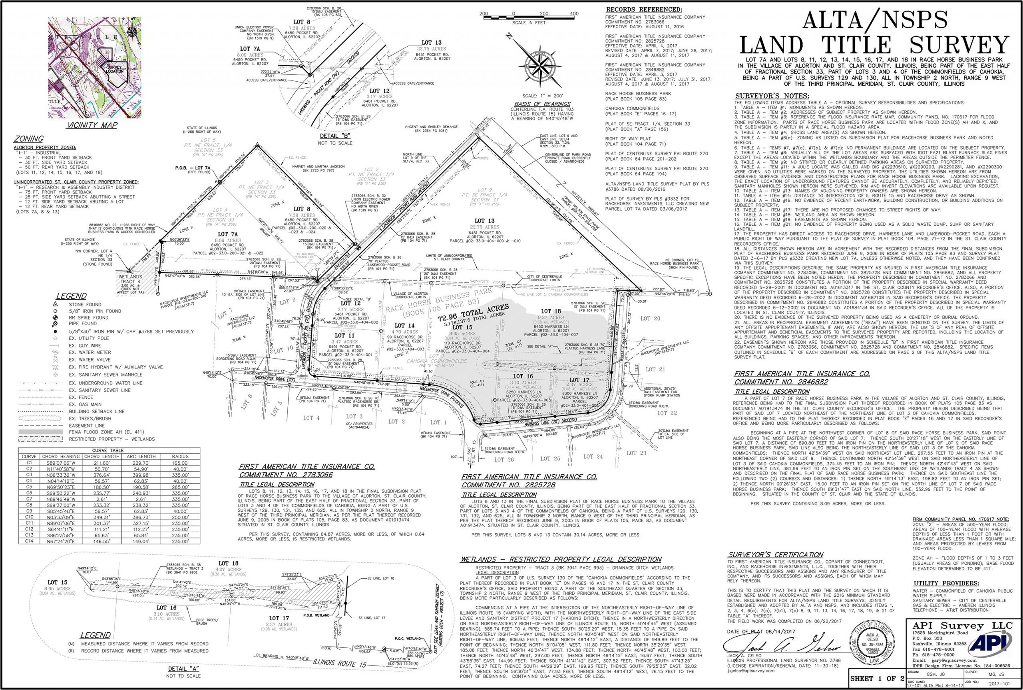
C. Required Elements
Section 8: Deliverables
Plat or Map
The surveyor must provide copies of the plat/map to:
Client
Insurer
Others identified by client
Hardcopy and/or digital as specified by client.
Plat recorded or filed in public office if required by state or local laws.

Slide 51
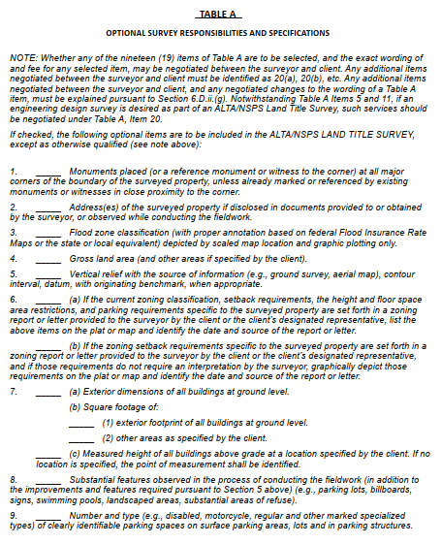
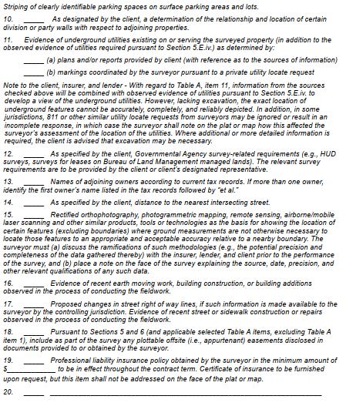
D. Table A
Table A is used to customize the survey for local conditions, lending institution needs, and local ordinances.
May or may not have effect on title.
Nineteen optional specific items and one open for additional item(s).
What each entails and costs are negotiated between client and surveyor.

Slide 52
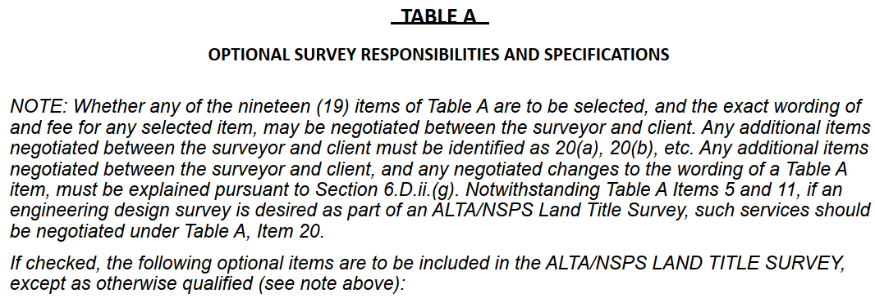
D. Table A
General Instructions
Scope and cost
Presentation

Slide 53
D. Table A
Fieldwork Modification
Standards
Section 5. Fieldwork - The survey must be performed on the ground (except as may be otherwise negotiated pursuant to Table A, Item 15 below)...
Table A

Slide 54
D. Table A
Extra Items
(a)
(b)
(c)

Slide 55
E. Summary
An ALTA/NSPS Land Title Survey is a few significant steps above a traditional property survey:
Property survey emphasis is boundary creation or retracement.
LTS can also create or retrace boundaries, but includes determination of objects, improvements, occupation, deeper dive on easements and other encumbrances, etc.
The Minimum Standard Detail Requirements contains a lot of detail to help guide surveyor.
The only “rigid” requirements are the minimum survey and plat contents & RPP.
How to achieve these is left to the surveyor to determine

Slide 56
E. Summary
Information and help is available
Gary Kent, PS, is the expert on ALTA/NSPS Standards
He is NSPS liaison on ALTA/NSPS and has been involved with the standards evolution
Writes and presents a lot on ALTA/NSPS
The American Surveyor Magazine
National and State conferences
Has been in Wis a few times
Mentoring Mondays presentations (https://mentoringmondays.xyz)
Has a series of short courses on GeoLearn (https://geo-learn.com)

Slide 57
ALTA/NSPS Land Title Surveys
✓ A. Background
✓ B. ALTA/NSPS Standards Organization
✓ C. Required Elements
✓ D. Table A
✓ E. Summary

Slide 58
Assignment
Question 1. While performing a survey you encounter what appears to be an access easement across the property which does not appear in the title report provided you by the title insurer. You do some additional research and in a few adjoiner records find language which could line up the suspected access easement. What should you do?
a. Advise the insurer of the discovered easement records before map delivery.
b. Because the easement wasn’t in the title report, don’t show it on the map but add “...and subject to all easements of record” to the Certification statement.
c. Show the easement on the map.
d. Add a note to the map stating there is a potential blanket easement.

Slide 59
Assignment
Question 1. While performing a survey you encounter what appears to be an access easement across the property which does not appear in the title report provided you by the title insurer. You do some additional research and in a few adjoiner records find language which could line up the suspected access easement. What should you do?
a. Advise the insurer of the discovered easement records before map delivery.
b. Because the easement wasn’t in the title report, don’t show it on the map but add “...and subject to all easements of record” to the Certification statement.
c. Show the easement on the map.
d. Add a note to the map stating there is a potential blanket easement.
Reference: Sec 6.C.viii

Slide 60
Assignment
Question 2. A creek is the boundary on one side of a property. In the metes and bounds description the course is described as “...to Adams Creek; thence along said Creek to a point that is S56°25’10”W and 35.56 ft from an 8inch white oak; thence......”. Your map must show: (select all that apply)
a. the date the water boundary was measured
b. the stream width
c. whether the stream is navigable or not.
d. a note that the water boundary is subject to change.

Slide 61
Assignment
Question 2. A creek is the boundary on one side of a property. In the metes and bounds description the course is described as “...to Adams Creek; thence along said Creek to a point that is S56°25’10”W and 35.56 ft from an 8inch white oak; thence......”. Your map must show: (select all that apply)
a. the date the water boundary was measured
b. the stream width
c. whether the stream is navigable or not.
d. a note that the water boundary is subject to change.
Reference: Sec 6.B.vi.

Slide 62
Assignment
Question 3. The Relative Positional Precision is a function of
a. systematic errors
b. random errors
c. mistakes
d. personnel training

Slide 63
Assignment
Question 3. The Relative Positional Precision is a function of
a. systematic errors
b. random errors
c. mistakes
d. personnel training
Reference: Sec 3.E.iv.

Slide 64
Assignment
Question 4. The found corners of a four-sided parcel are measured using RTK tied to a CORS base station. Between which points must the Relative Positional Precision be met?
a. A & C, B & D
b. A & B, B & C, C & D, D & A
c. A & B, B & C, C & D, D & A, A & C, B & D
d. Each of the four corners and the CORS station
B
A
C
D

Slide 65
Assignment
Question 4. The found corners of a four-sided parcel are measured using RTK tied to a CORS base station. Between which points must the Relative Positional Precision be met?
a. A & C, B & D
b. A & B, B & C, C & D, D & A
c. A & B, B & C, C & D, D & A, A & C, B & D
d. Each of the four corners and the CORS station
Reference: Sec 3.E.i.
B
A
C
D

Slide 66
Assignment
Question 5. Which of the following records for an existing parcel must be provided to the surveyor? Select all that apply.
a. Current record description
b. Certificate of taxes paid
c. Descriptions of adjoiners unless they are lots in a recorded subdivision
d. Abstract of title

Slide 67
Assignment
Question 5. Which of the following records for an existing parcel must be provided to the surveyor? Select all that apply.
a. Current record description
b. Certificate of taxes paid
c. Descriptions of adjoiners unless they are lots in a recorded subdivision
d. Abstract of title
Reference: Sec 4

Slide 68
Assignment
Question 6. If the client does not provide record information on easements then the surveyor is obligated to :
a. do nothing as the information was the client’s responsibility.
b. perform his/her own research to ensure encumbrances be identified.
c. only show on the map any observed easement evidence.
d. show any observed easement evidence on the map and add “...and subject to all easements of record” to the Certification statement.

Slide 69
Assignment
Question 6. If the client does not provide record information on easements then the surveyor is obligated to :
a. do nothing as the information was the client’s responsibility.
b. perform his/her own research to ensure encumbrances be identified.
c. only show on the map any observed easement evidence.
d. show any observed easement evidence on the map and add “...and subject to all easements of record” to the Certification statement.
Reference: Sec 4.

Slide 70
Assignment
Question 7. The sheet size for the Land Title Survey map must be:
a. 8-1/2” x 11”
b. 8-1/2” x 11” or larger
c. 8-1/2” x 14”
d. 8-1/2” x 14” or larger

Slide 71
Assignment
Question 7. The sheet size for the Land Title Survey map must be:
a. 8-1/2” x 11”
b. 8-1/2” x 11” or larger
c. 8-1/2” x 14”
d. 8-1/2” x 14” or larger
Reference: Sec D.i.

